Slide 1
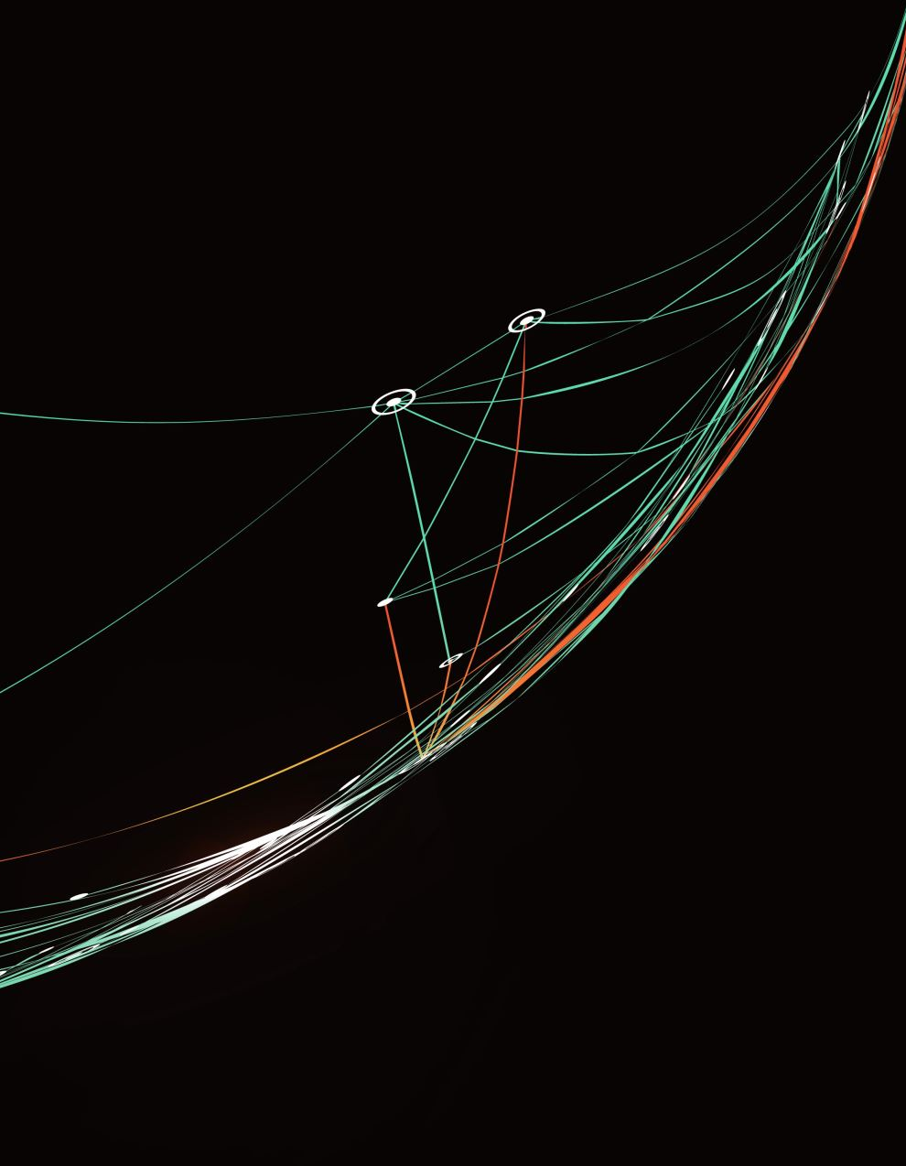
Data Visualization of Bird Strikes between 2000 – 2011
Dataset Source: Federal Aviation Administration (FAA)
Time Period: 2000-2011
Significance:
Bird strikes can result in fatal accidents, emphasizing the need for a deeper understanding.
Increasing vehicular traffic and urbanization amplify environmental concerns.

Slide 2
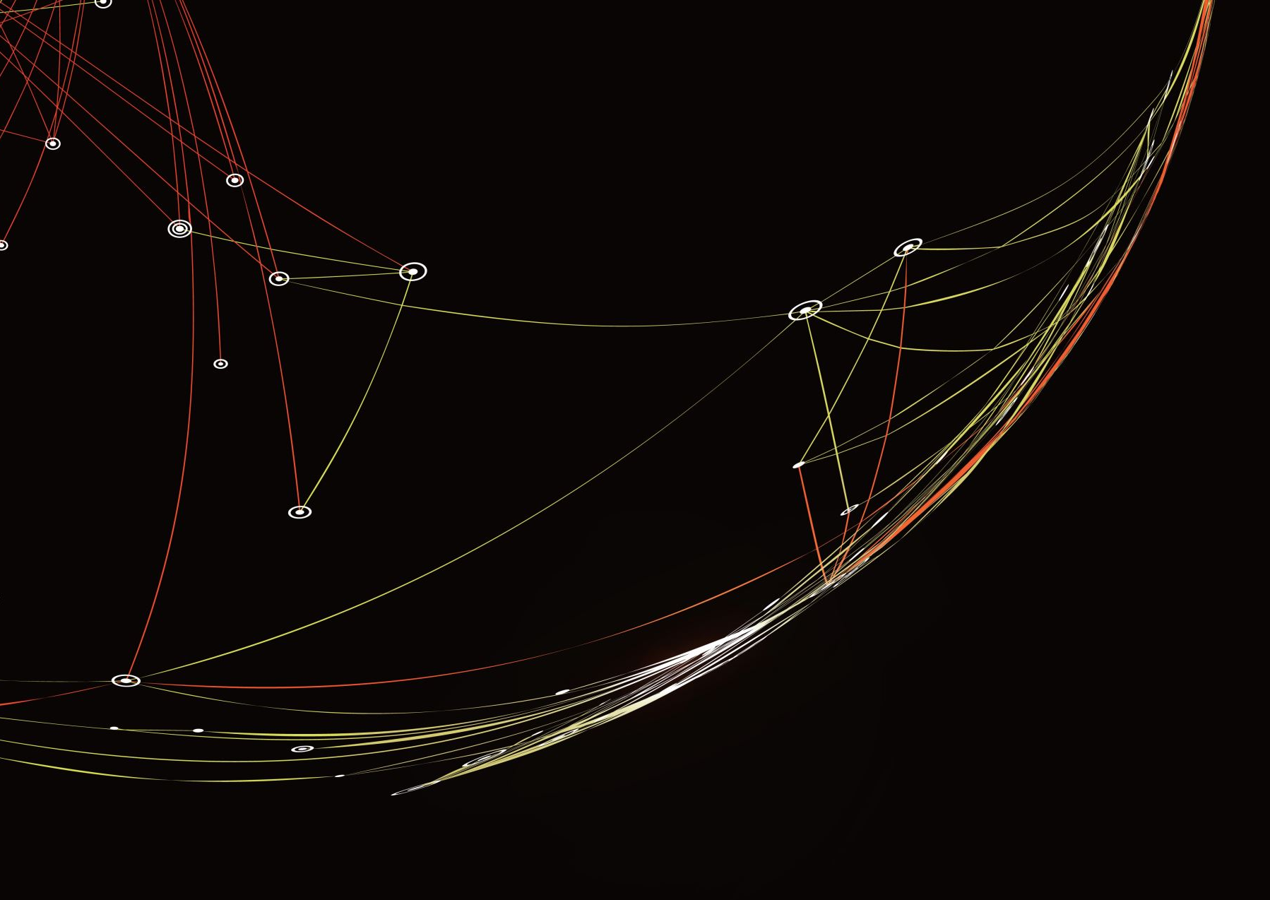
Goals: our goal is to visualise the dataset
Visualization:
Consider including a snapshot or visual representation of the dataset. This could be a chart showing the distribution of bird strikes over the years or a geographical map indicating incident hotspots.

Slide 3
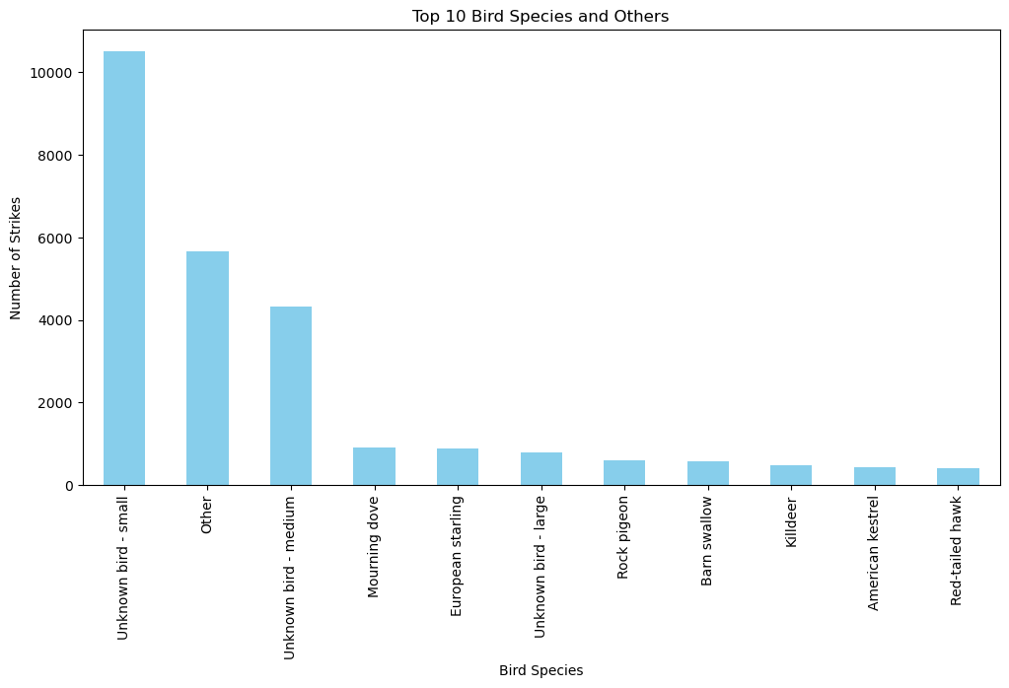
The top ten bird species which are having the most strikes to the aircrafts .

Slide 4
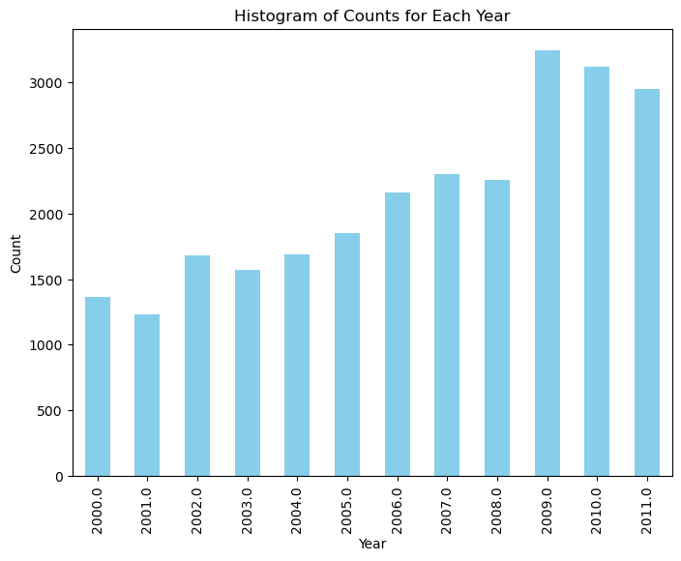
Yearly Analysis & Bird Strikes in the US

Slide 5
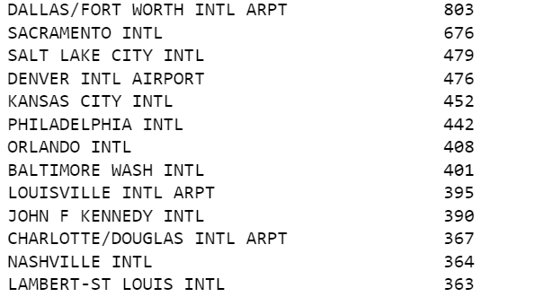
Airports with most incidents of bird strikes – Top 50
Some of the top 50 Airport are as follows:

Slide 6
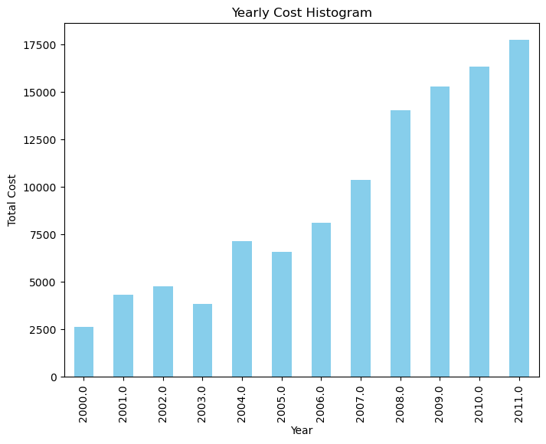
Yearly Cost Incurred due to Bird Strikes:
Fom the above the maximum cost in 2011

Slide 7
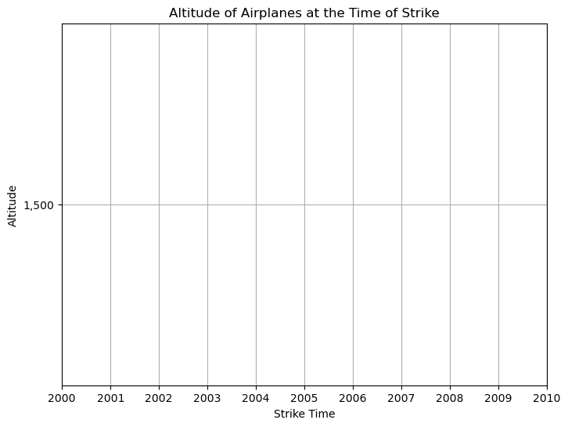
Average Altitude of aeroplanes at the time of strike
The average altitude from the above viualisation will be concluded as 1500 ft .

Slide 8
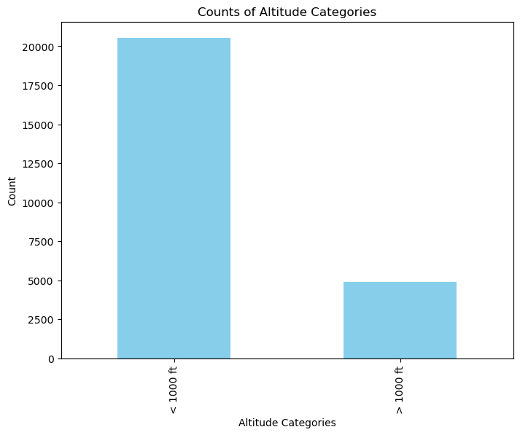
Effect of Strike at Different Altitude
The most number of strikes are occurred when the altitude is less than 1000 ft from the ground

Slide 9
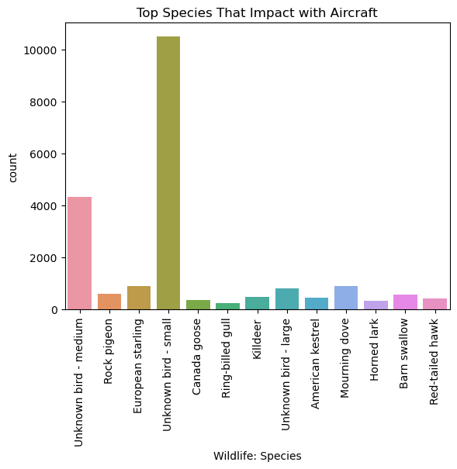
Top species that are impacting the Aircraft are

Slide 10
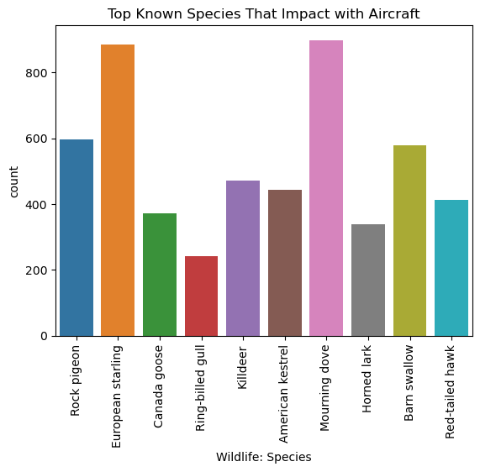
Known species that are impacting the aircraft

Slide 11
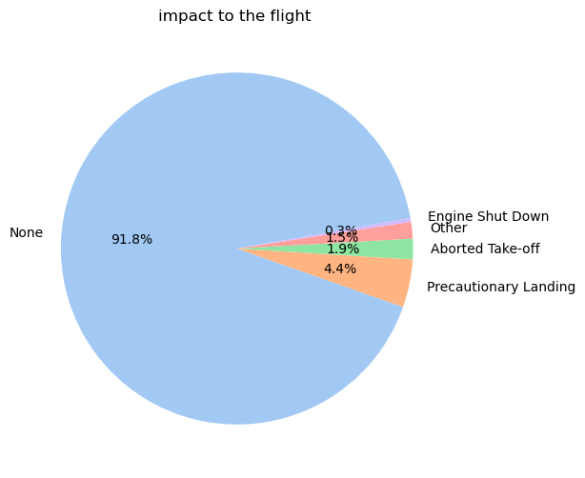
what was the wildlife srtrike impact to the aircraft?¶
From the above visualisation we conclude that the most of the strikes are occurred when the craft in aborted take- off mode .

Slide 12
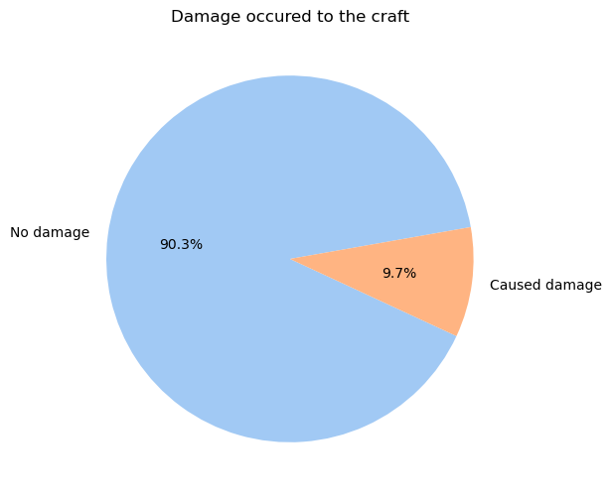
Does there was a damge after the strike of the bird ?¶

Slide 13
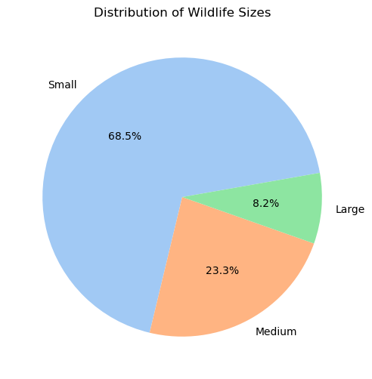
what was thesize of the wildlife that strike to the aircraft ?

Slide 14
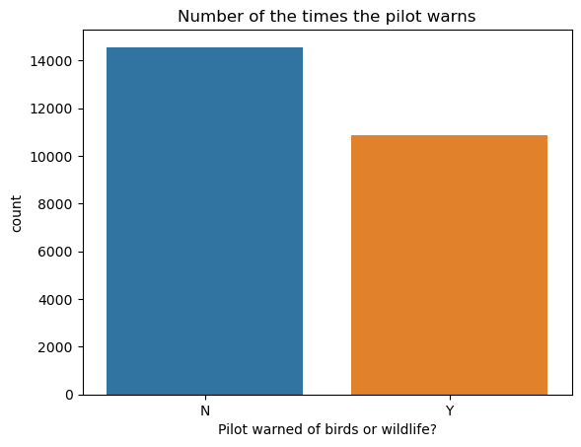
How many times the pilot warned about the wildlife ?

Slide 15
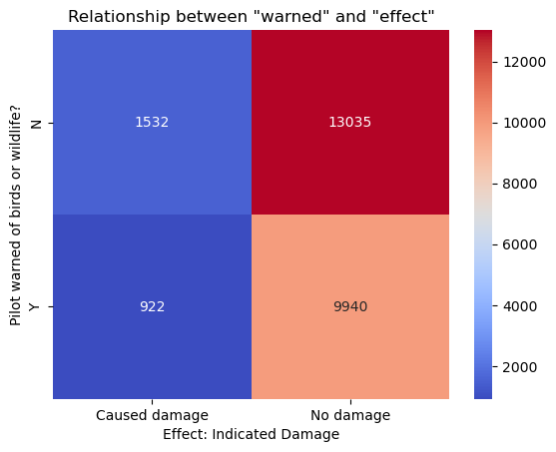
Prior Warning and Effect of Strike Relation

